Slide 1

Introduction
Application Development

Slide 2
What is Application Development
Application development is the process of creating a computer program or a set of programs to perform the different tasks that a business requires. From calculating monthly expenses to scheduling sales reports, applications help businesses automate processes and increase efficiency. Every app-building process follows the same steps: gathering requirements, designing prototypes, coding, testing, implementation, and integration

Slide 3
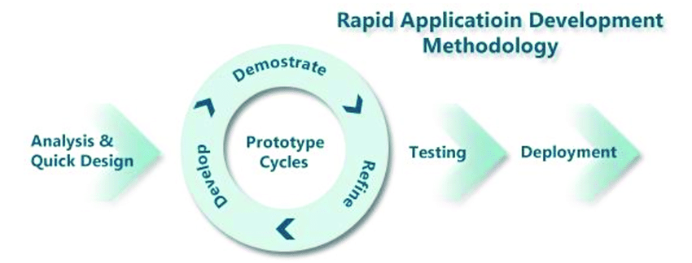

Slide 4
App/Software Development Process
In the software development service, six basic steps define the process of software development. They are:
General Analysis and Requirements Gathering
Product Design
Coding (Our Job)
Testing
Deployment of product
Product Maintenance and Operations
https://www.manifera.com/6-basic-steps-software-development-process/
Notes:
When explaining use examples, like example you can use Gojek App as example. How the app is build.

Slide 5
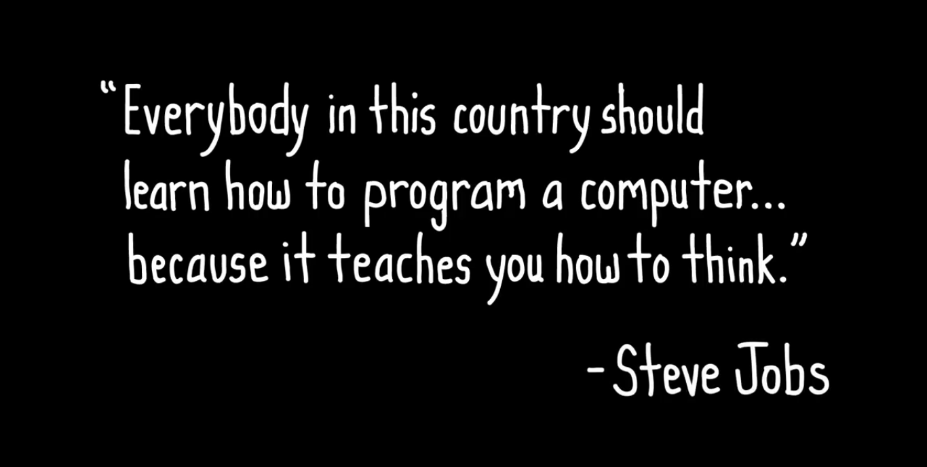
Why Should You Learn to Code?

Slide 6
Programming Languages
Remember our goal is learning to be able to build a Web App or Mobile App. And there are so many Programming Languages we can choose to build an Application, like example : Javascript, Java, Python, Go, C#, PHP, and many more.
And in Purwadhika we are going to use Javascript Programming Language.

Slide 7

Why Should You Learn Javascript?
1. Easy to start with
2. Great career oportunities
3. Wide range of usage
4. Big community
5. lots of sources to learn

Slide 8
Why Should You Learn Javascript?
JavaScript is one of the 3 languages all web developers must learn:
1. HTML to define the content of web pages
2. CSS to specify the layout of web pages
3. JavaScript to program the behavior of web pages
Web pages are not the only place where JavaScript is used. Many desktop and server programs use JavaScript. Node.js is the best known. Some databases, like MongoDB and CouchDB, also use JavaScript as their programming language.

Slide 9
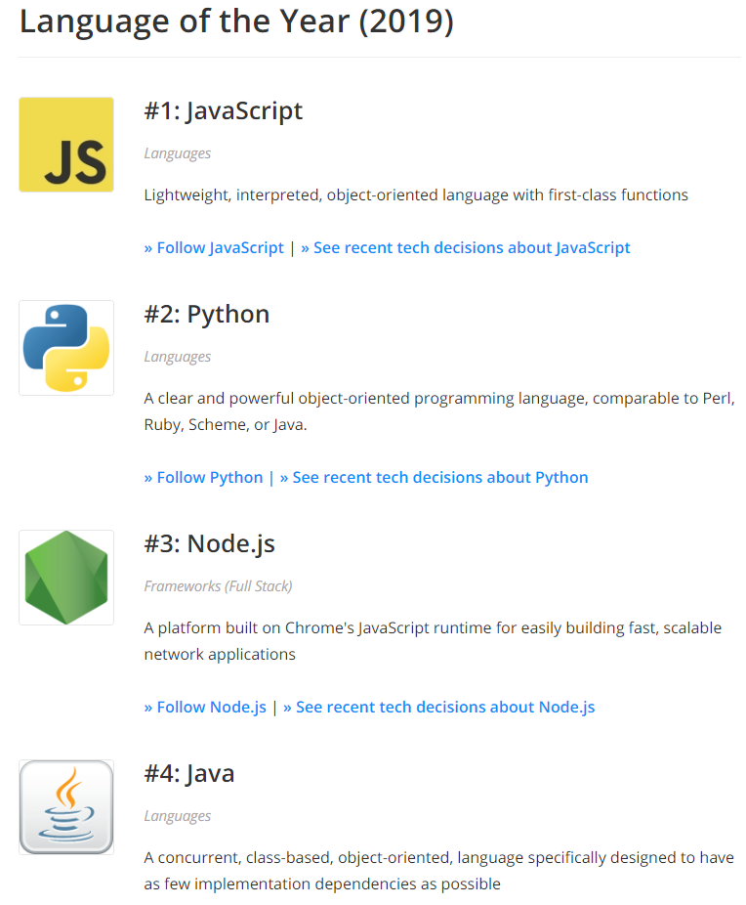
Language of the Year 2019
https://stackshare.io/posts/top-developer-tools-2019

Slide 10
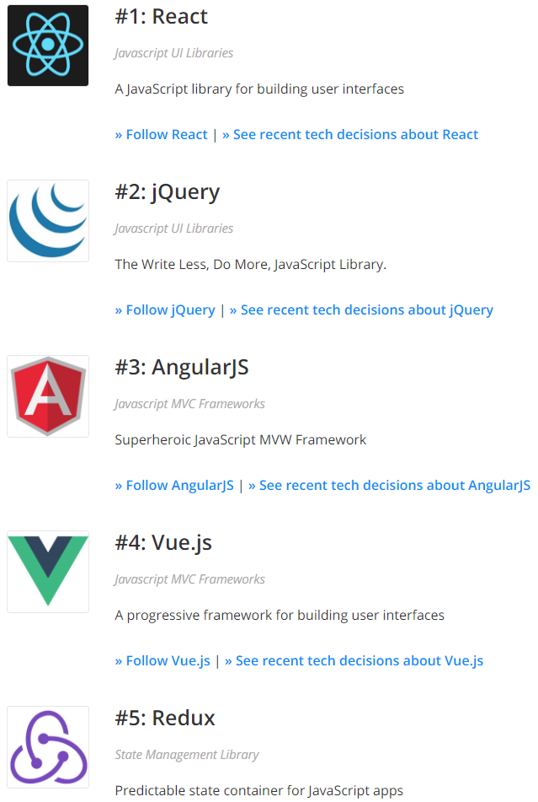
Front-end Framework of the Year 2019
https://stackshare.io/posts/top-developer-tools-2019

Slide 11
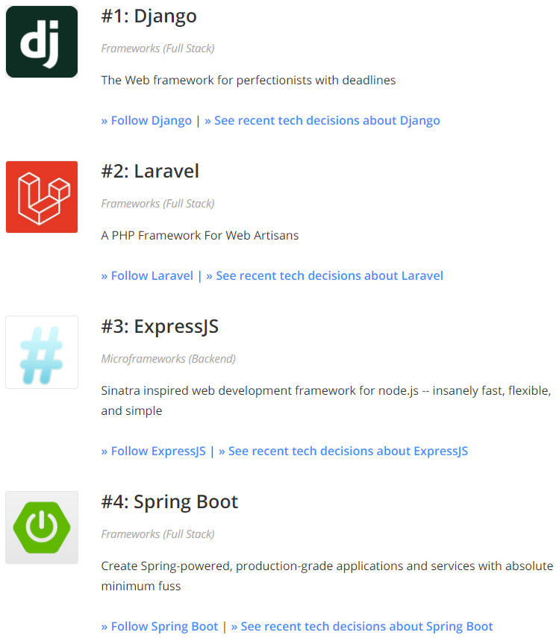
Backend/Full Stack Framework of the Year 2019
https://stackshare.io/posts/top-developer-tools-2019

Slide 12

Application Hosting Tool of the Year 2019
https://stackshare.io/posts/top-developer-tools-2019

Slide 13
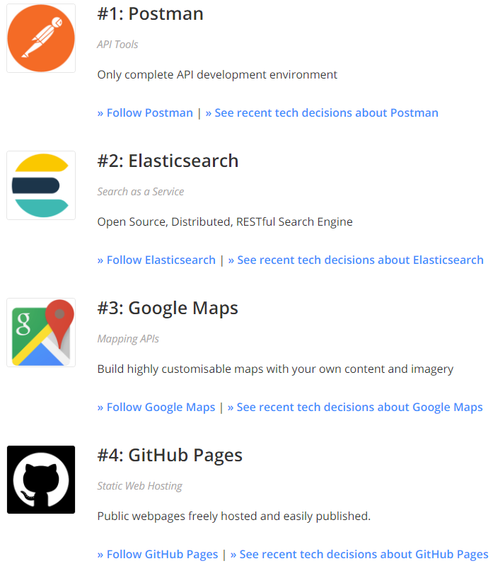
Application Utility of the Year 2019
https://stackshare.io/posts/top-developer-tools-2019

Slide 14
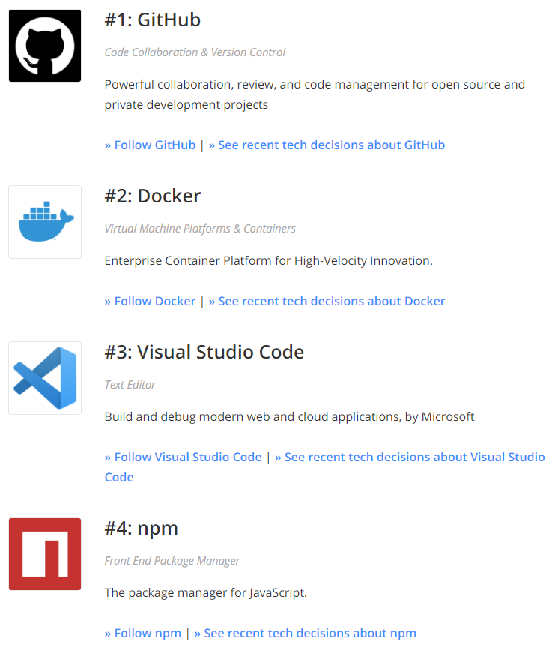
Build, Test, & Deploy Tool of the Year 2019
https://stackshare.io/posts/top-developer-tools-2019

Slide 15
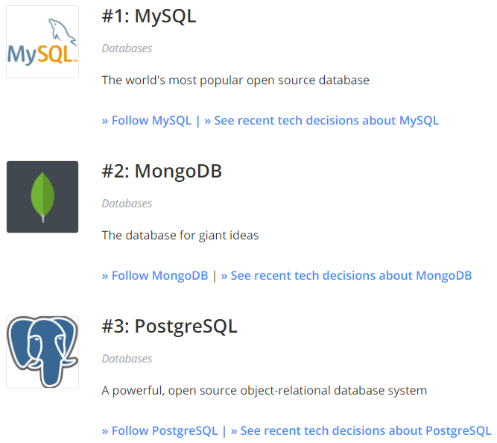
Data Store/Tool of the Year 2019
https://stackshare.io/posts/top-developer-tools-2019

Slide 16
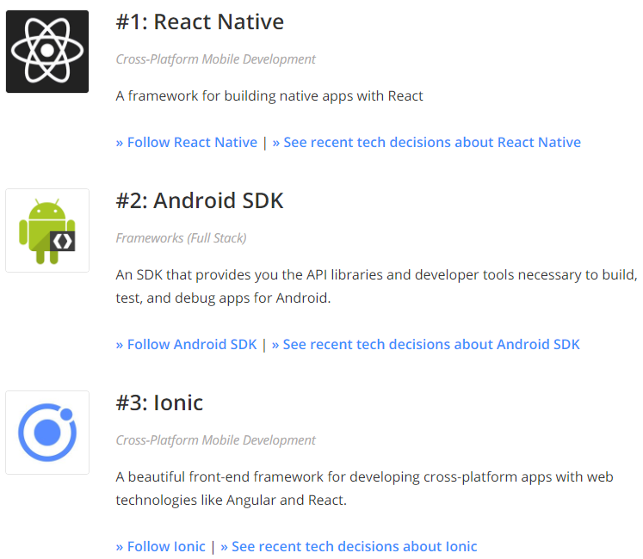
Mobile Tool of the Year 2019
https://stackshare.io/posts/top-developer-tools-2019

Slide 17
JavaScript often abbreviated as JS, is a high-level, dynamic, weakly typed, and interpreted programming language.
Alongside HTML and CSS, JavaScript is one of the three core technologies of World Wide Web content production.

Slide 18
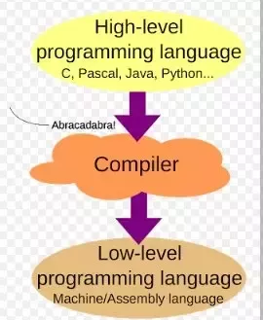
High Level vs Low Level Programming Languages
We humans communicate with different languages. But how the computers communicate..? Do they use english,Tamil,Hindi, Telugu etc .., to communicate…? Absolutely a big NO . It knows only 0′s and 1′s . Computers can understand the instructions that are composed of 0′s and 1′s . Instructions given to the computer in 0’s and 1’s is known as binary language( also known as machine language).
Then, as the programmers found writing code in binary language seems to be difficult, then they used a English like words to write a program. This language is known as assembly language.
These two , machine level language and the assembly level language together considered as the low level languages.

Slide 19
High Level vs Low Level Programming Languages
The programming languages which are machine independent and are written in a English language is known as the high level languages . some of the examples of high level language are c, c++,java,javascript…etc
These high level languages will be converted into a machine readable form by a compiler or interpreter.
DIFFERENCE BETWEEN THE HIGH AND THE LOW LEVEL LANGUAGE:
Low level language is machine readable form of program. Whereas the high level language will be in human readable form..
Low level language are difficult to write and compile but high level languages are easy to write as well as compile..
Low level language are compact and require less memory space.. High level language uses compilers and interpreters which requires large memory space.
In high level language debugging ( troubleshooting) .I.e. Finding and correcting errors are easier whereas debugging in the low level language is quite difficult.
low level language coding and compiling is time consuming process whereas high level language coding and compiling is much easy and takes veryless time to compile.

Slide 20
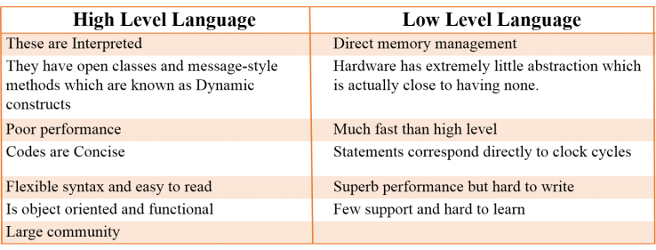

Slide 21
Compiled vs Interpreted
“When source code is translated”
Source Code: Original code (usually typed by a human into a computer)
Translation: Converting source code into something a computer can read (i.e. machine code)
Run-Time: Period when program is executing commands (after compilation, if compiled)
Compiled: Code translated before run-time
Interpreted: Code translated on the fly, during execution

Slide 22
Typing
“When types are checked”
"3" + 5 will raise a type error in strongly typed languages, such as Python and Go, because they don't allow for "type coercion": the ability for a value to change type implicitly in certain contexts (e.g. merging two types using +). Weakly typed languages, such as JavaScript, won't throw a type error (result: '35’).
Static: Types checked before run-time
Dynamic: Types checked on the fly, during execution
The definitions of “Static & Compiled” and “Dynamic & Interpreted” are quite similar…but remember it’s “when types are checked” vs. “when source code is translated”.
Type-checking has nothing to do with the language being compiled or interpreted! You need to separate these terms conceptually.

Slide 23
You will understand it better later the Definitions above about Programming Languages and the Differences, when you already learn how to code using Javascript.
So just relax, and you can even forget it for now, because its not the most important things to know.

Slide 24
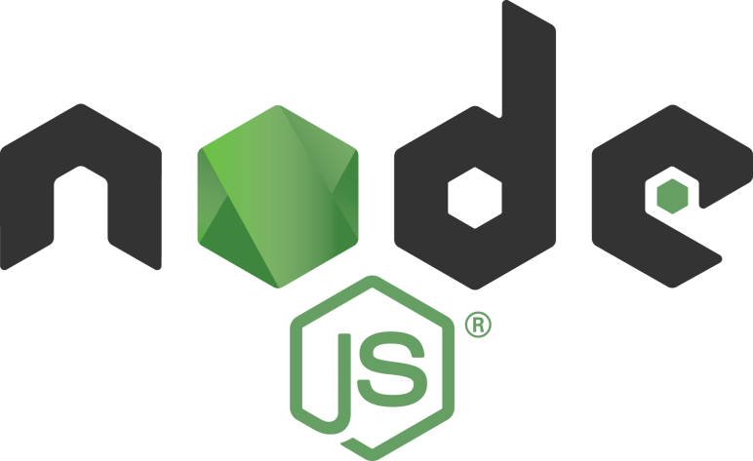
Node.js® is a JavaScript runtime built on Chrome's V8 JavaScript engine. Node.js uses an event-driven, non-blocking I/O model that makes it lightweight and efficient. Node.js' package ecosystem, npm, is the largest ecosystem of open source libraries in the world.
So in short, Node.js is the one that make JavaScript can be run outside of a web browser.

Slide 25


SetUp
Visual Studio Code
Download & install here:
code.visualstudio.com
Node.Js
Download & install here:
nodejs.org
$ node --version
$ node -v

Slide 26
Make your first JS file #1
<Running on command prompt #1>
console.log('Halo');
* Simpan sebagai file.js
* Buka terminal <run cmd>
* Masuk ke direktori file.js
* Eksekusi node file.js

Slide 27

JavaScript Programs & Statements
A computer program is a list of "instructions" to be "executed" by a computer.
In a programming language, these programming instructions are called statements.
A JavaScript program is a list of programming statements.
Most JavaScript programs contain many JavaScript statements.
The statements are executed, one by one, in the same order as they are written.

Slide 28
Semicolons ;
Semicolons separate JavaScript statements.
When separated by semicolons, multiple statements on one line are allowed:

Slide 29
JavaScript Output
JavaScript Display Possibilities
JavaScript can "display" data in different ways:
Writing into an HTML element, using innerHTML.
Writing into the HTML output using document.write().
Writing into an alert box, using window.alert() or alert().
Writing into the browser console, using console.log().
We already tried the console.log(), but we tried it on js file not on html file. And we run the code using node js in command prompt and not using web browser, so we will try the old way of running JavaScript (running in web browser)

Slide 30
Make your first JS file #2
<console.log>
<script>
console.log('Halo Dunia');
</script>
* Simpan sebagai file.html
* Buka file.html di browser
* Inspect & lihat hasil di tab console

Slide 31
Make your first JS file #3
<document.write>
<script>
document.write('Halo Dunia');
</script>
* Simpan sebagai file.htm
* Buka file.htm di browser
* Hasil langsung terlihat di page

Slide 32
Make your first JS file #4
<innerHTML>
<p id="demo"></p> <script> document.getElementById("demo").innerHTML = 5 + 6; </script>
* Simpan sebagai file.htm
* Buka file.htm di browser
* Hasil langsung terlihat di page

Slide 33
Make your first JS file #5
<alert>
<script>
alert('Halo Dunia');
</script>
* Simpan sebagai file.htm
* Buka file.htm di browser
* Hasil langsung terlihat di page

Slide 34
Make your first JS file #6
<combine all>
<p id="demo"></p>
<script>
alert('Halo Dunia’);
console.log('Halo Dunia’);
document.write('Halo Dunia’);
document.getElementById("demo").innerHTML = 5 + 6;
</script>
* Simpan sebagai file.htm
* Buka file.htm di browser
* Coba lihat hasilnya

Slide 35
Make your first JS file #7
<Running on browser, calling from HTML>
console.log('Halo');
* Simpan sebagai file.js
* Buat file HTML berikut (file.htm)
<script src="file.js"></script>
* Buka file.htm di browser
* Inspect & lihat hasil di tab console

Slide 36
Comment
JavaScript comments can be used to explain JavaScript code, and to make it more readable.
JavaScript comments can also be used to prevent execution, when testing alternative code.
// komentar 1 line
/*
komentar multiline
komentar multiline
komentar multiline
*/

Slide 37
dirname & filename
console.log(__dirname);
// menampilkan directory path
console.log(__filename);
// menampilkan file path

Slide 38
Introduction

